Slide 1
Introduction to HUB & software
BY ARVIND SESHAN

Slide 2
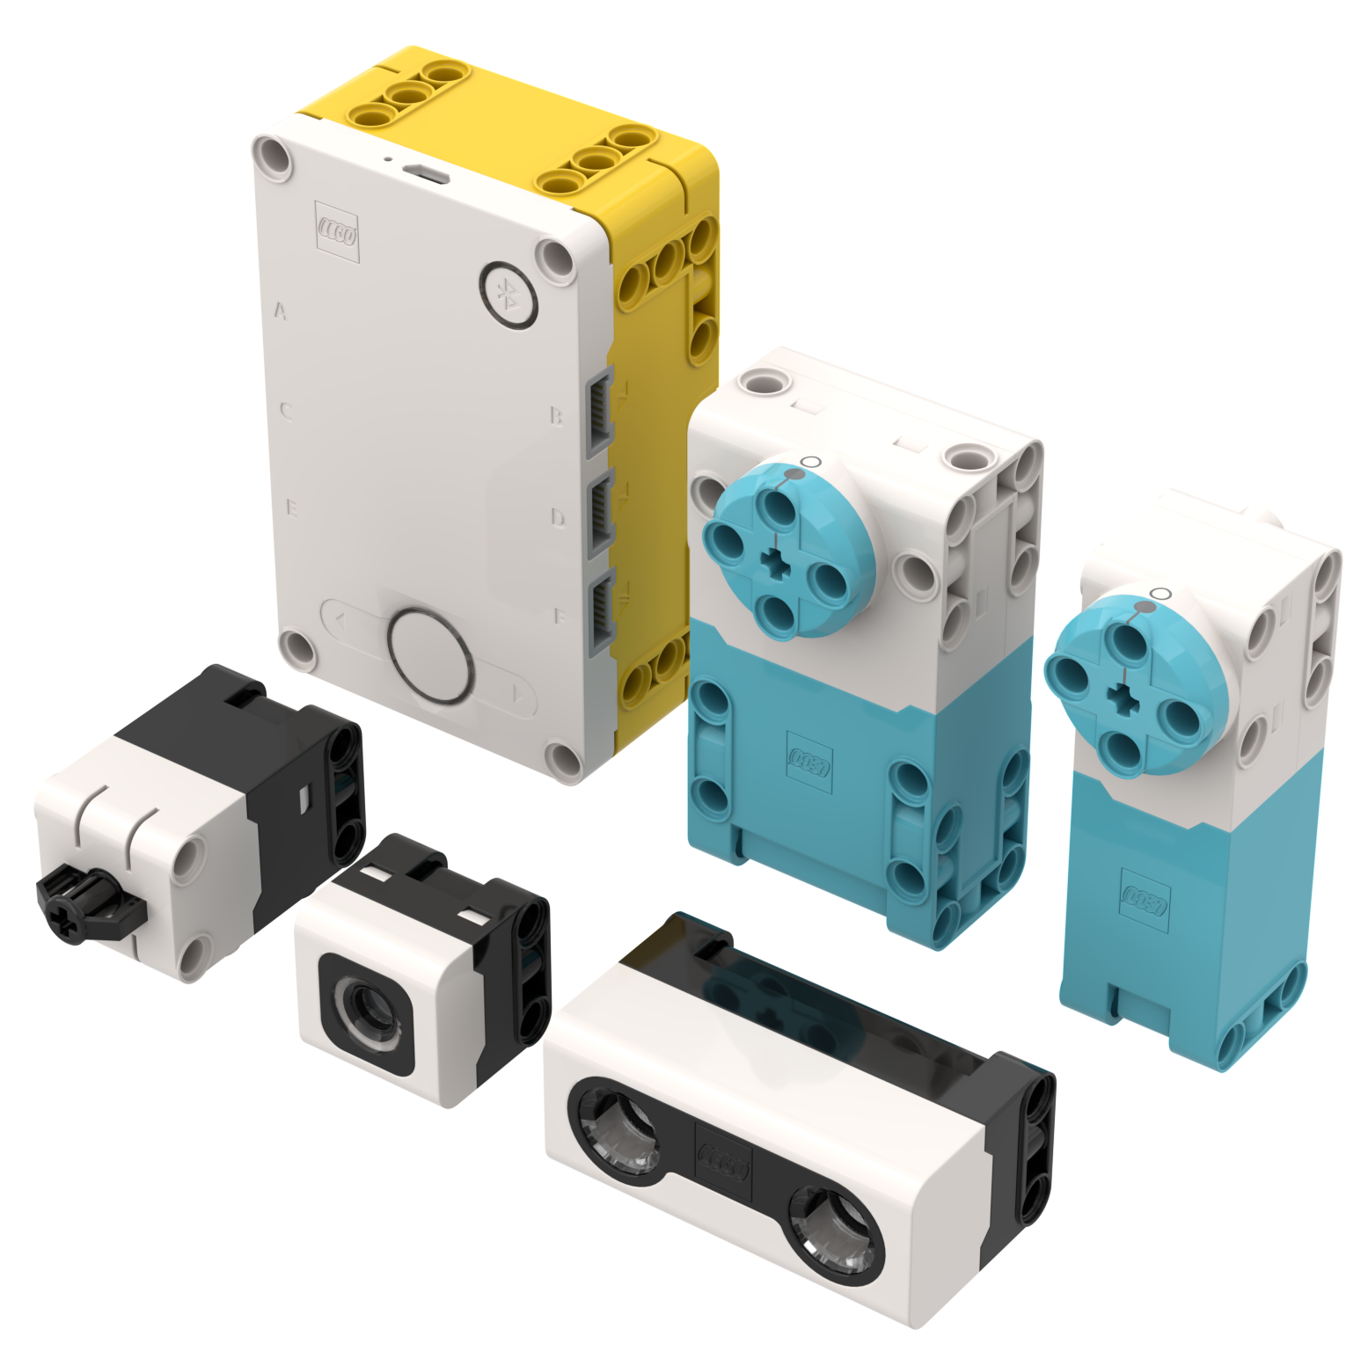
Lesson Objectives
Learn how the SPIKE Prime Hub operates
Learn about the main components of the SPIKE Prime Software
Learn how to connect your Hub

Slide 3
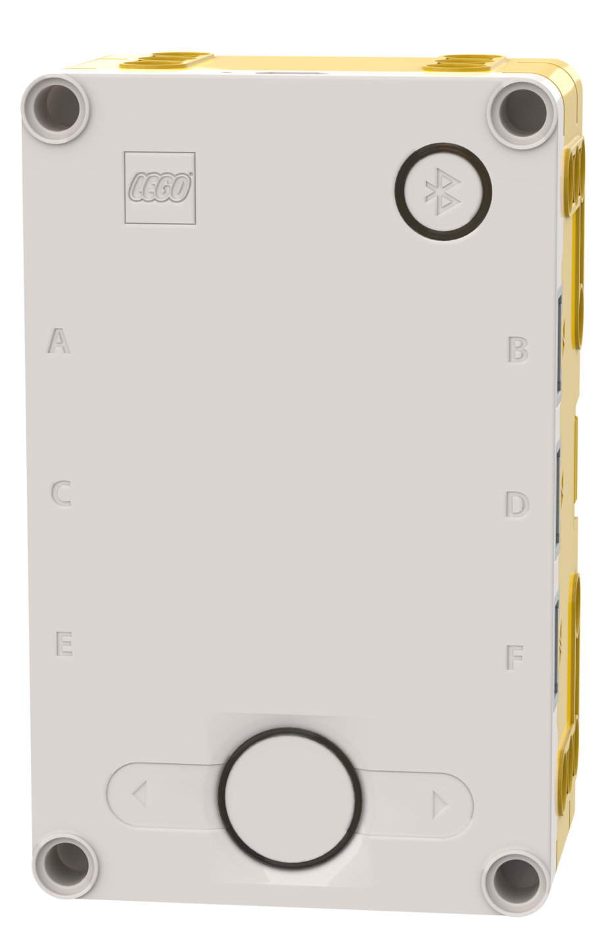
The Hub Buttons
Put Hub in Bluetooth pairing mode
Left button for program navigation in home menu
Select program or exit program when running. Hold down for 5 seconds to power off. Turns on Hub.
Right button for program navigation
1
3
2
4

Slide 4
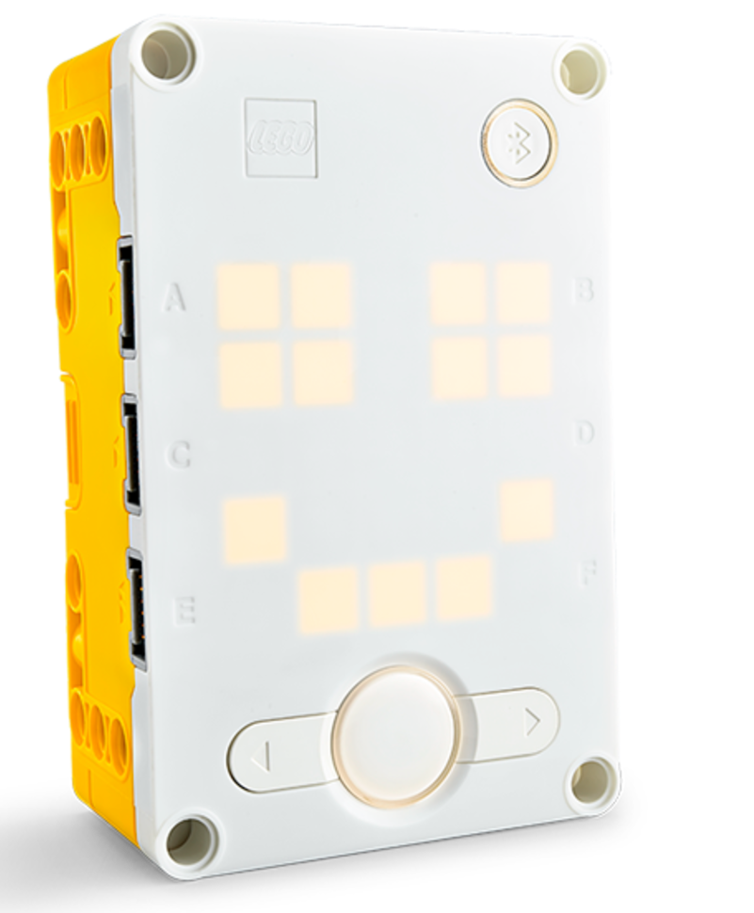
The Hub screen
5x5 LED pixel matrix can be used to make designs, but also pick programs
Patterns onscreen represent different programs
Use the arrows and center button to navigate/launch programs
You can have a maximum of 20 programs

Slide 5
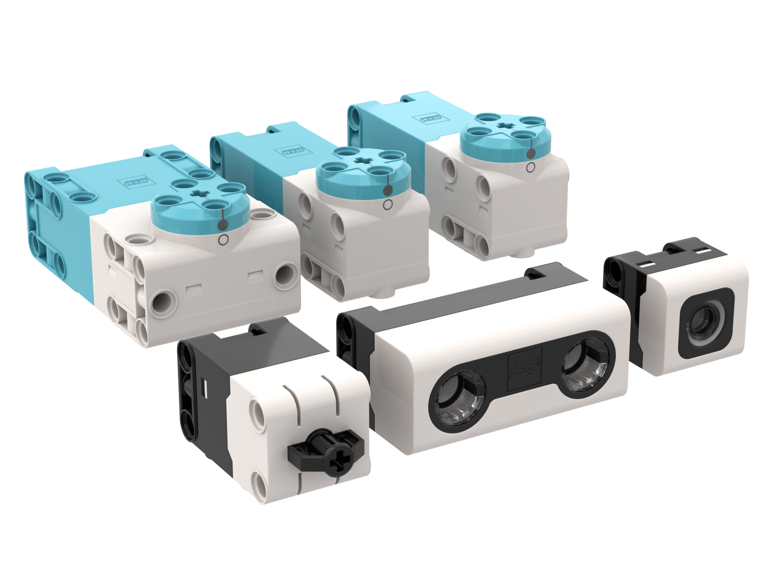
Ports, Motors and sensors
The hub has 6 built-in ports (A-F)
Any port can be used for any motor or sensor
The basic SPIKE PRIME set comes with 1 Large Motor and 2 Medium Motors, 1 Force Sensor, 1 Distance Sensor, 1 Color Sensor, and a built-in 6-axis IMU (3-axis accelerometer + 3-axis gyro)

Slide 6
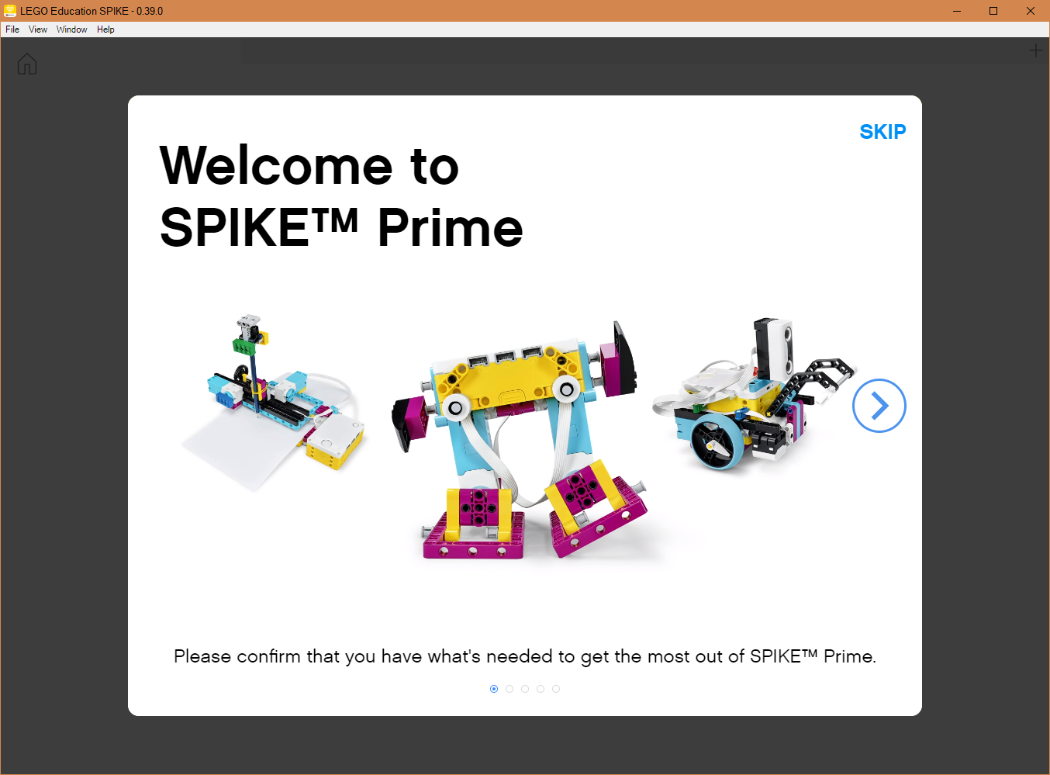
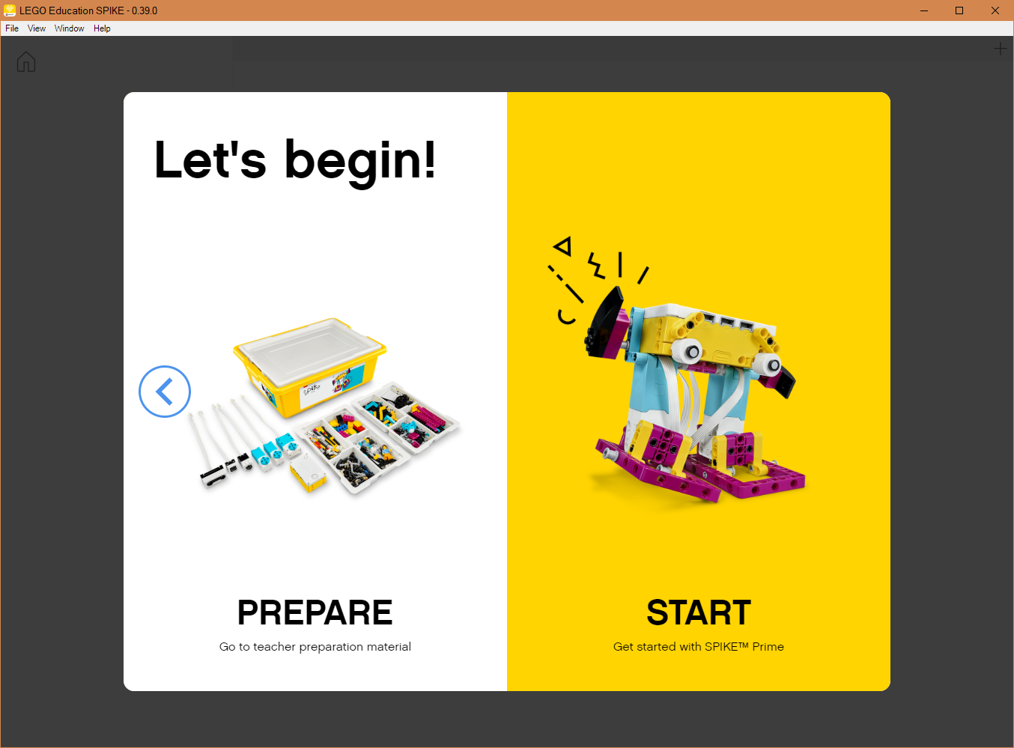
Getting Started
Follow the onscreen steps and then click “START” to access the programming environment

Slide 7
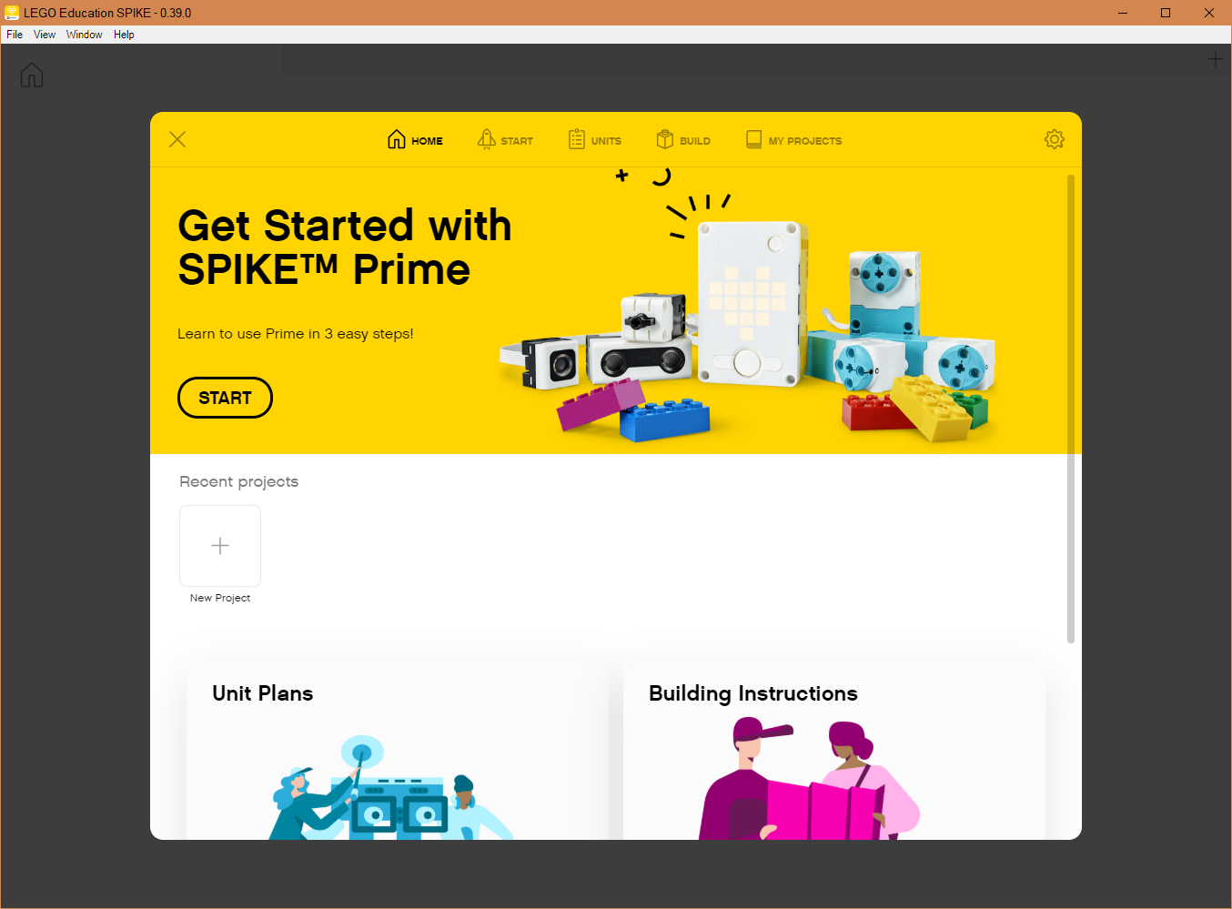
HOME MENU
Adding Curriculum
Build Instructions
Open Saved Project
Create New Project

Slide 8
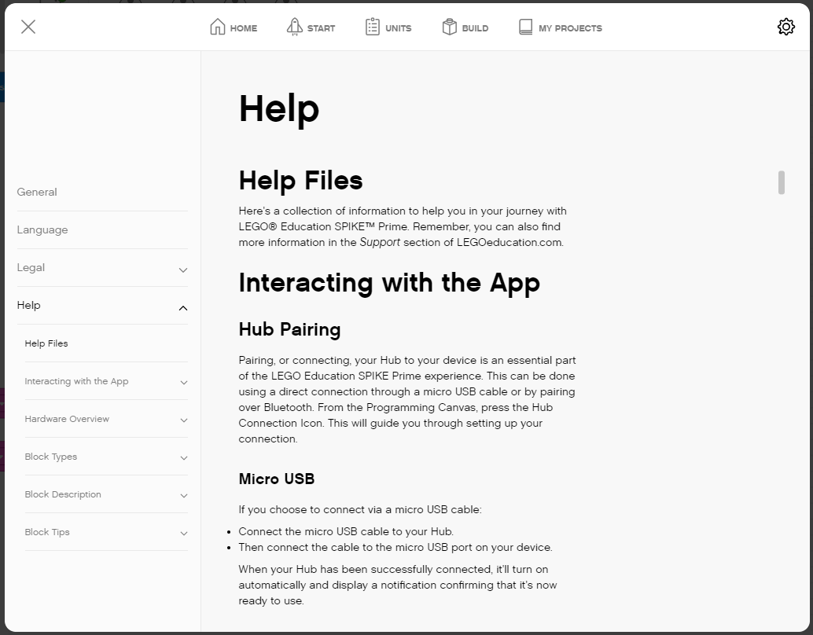
Accessing the HELP MENU
Click the Settings icon in the Home screen
Navigate to Help on the left hand column

Slide 9
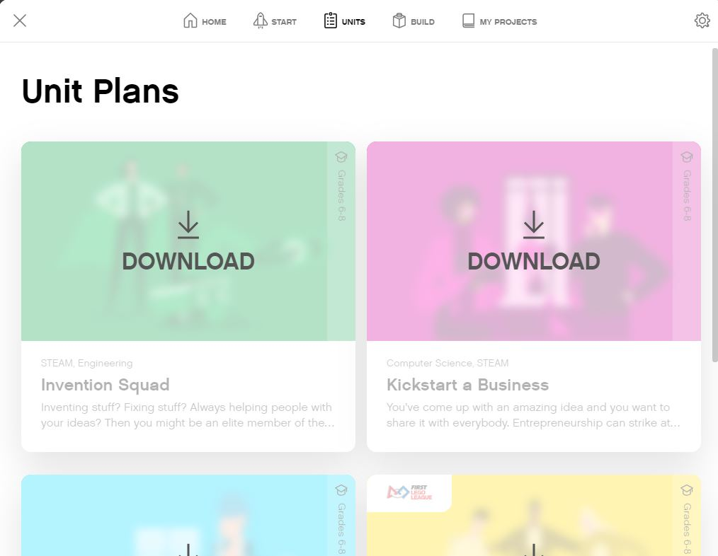
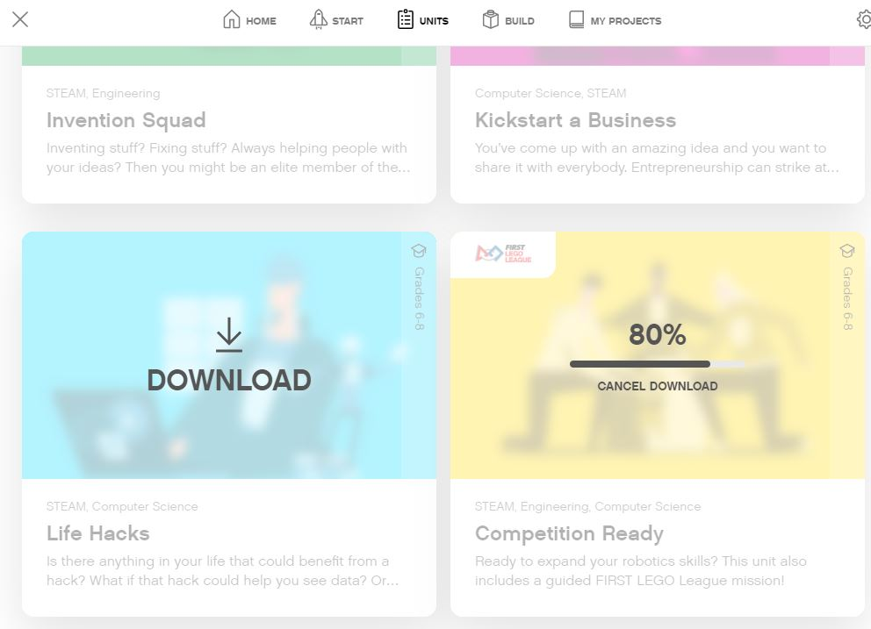
ADDING CURRICULUM - UNITS
Lesson Plans can be found in the Units Section from the Home Menu.
Section which unit you want to add and hit Download
The FIRST LEGO League Curriculum is called “Competition Ready’

Slide 10
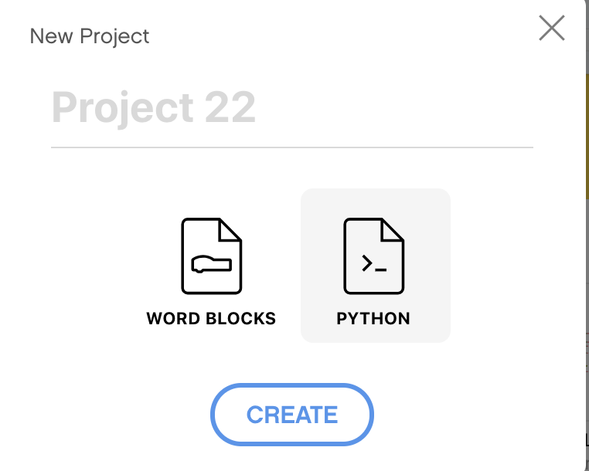
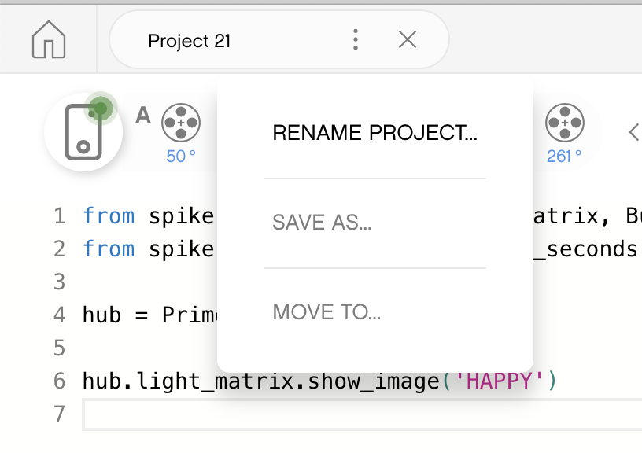
CREATING A PYTHON PROJECT
Select Python from the pop-up
Click on the three dots to change the file name

Slide 11
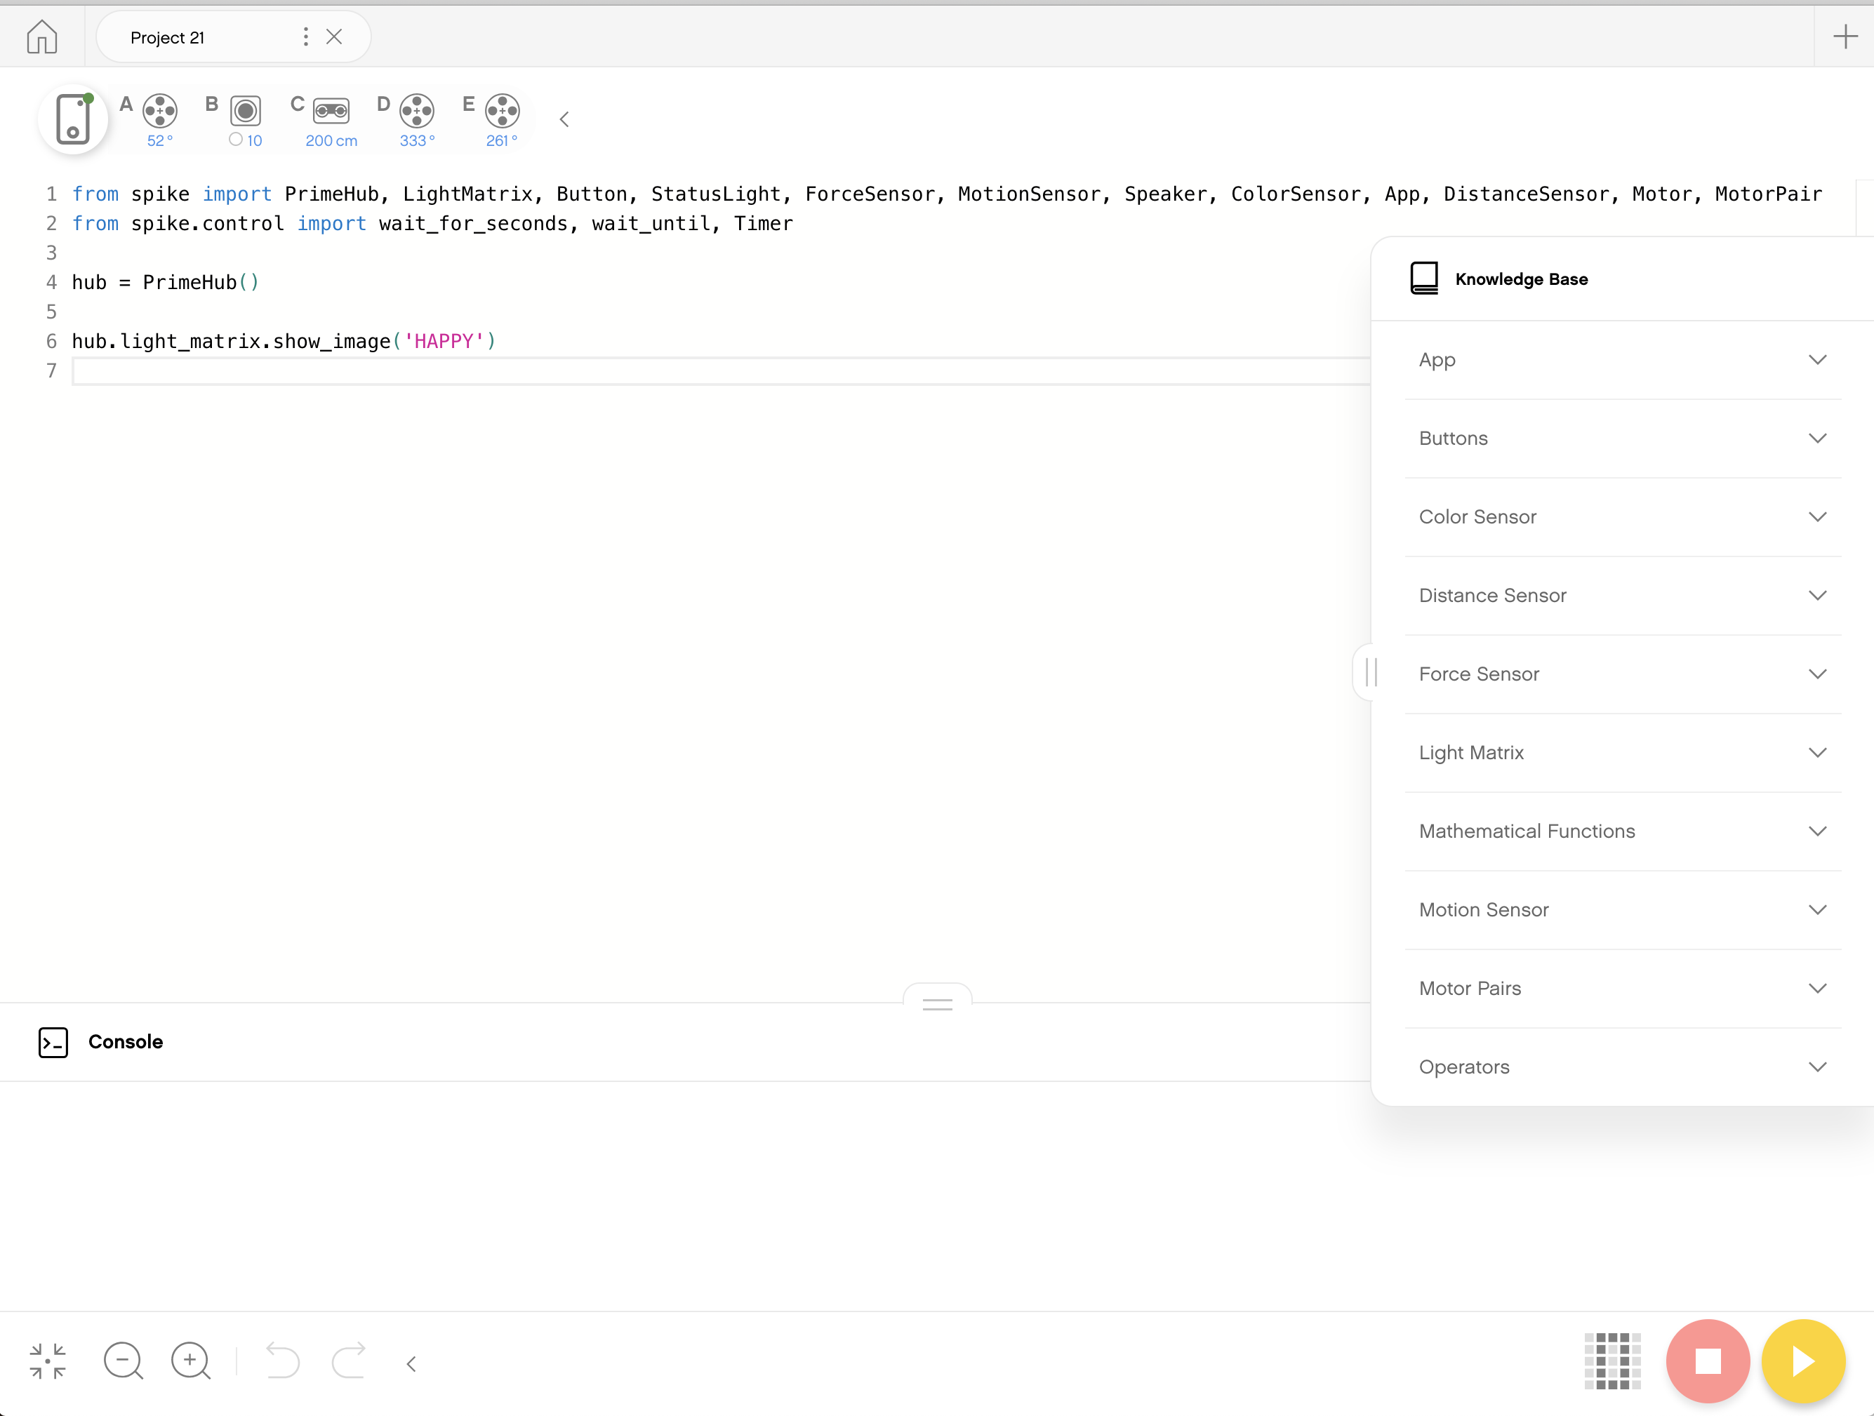
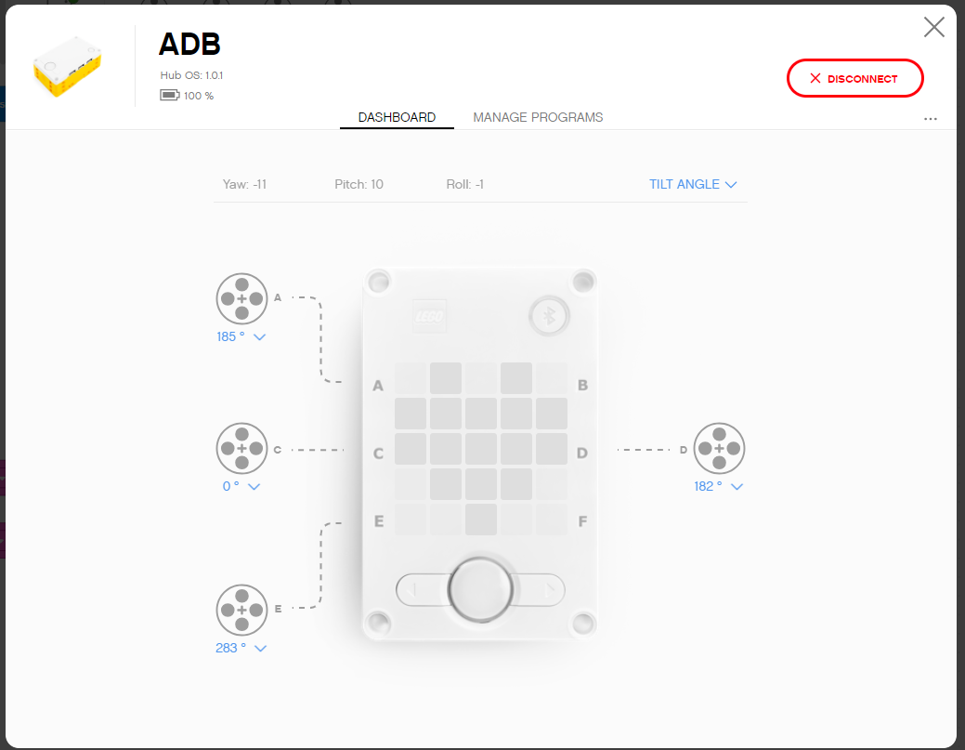
Programming Canvas
Knowledge Base: MicroPython Tips
Programming Canvas: The main programming canvas is where you will create each program (called ‘Project’)
The Connect Icon lets you access the Hub Dashboard
Stop/Play Icon lets you pick which slot to download the code to and run your code
Console; Anything you print as well as errors will show up here
Hub Dashboard
Programming Canvas
Console
Knowledge Base
Stop and Play

Slide 12
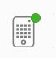
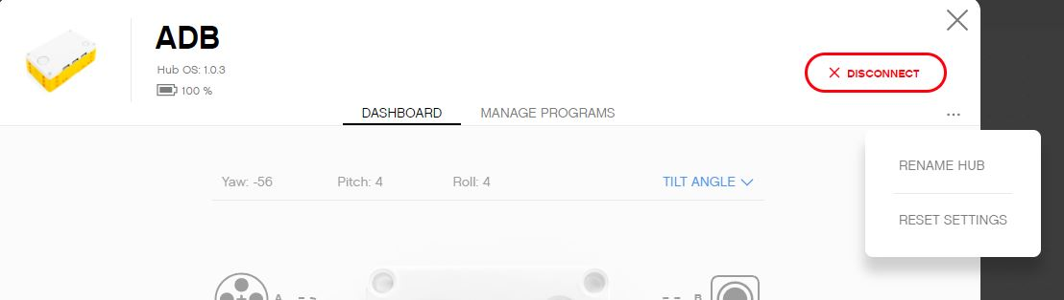
HUB DASHBOARD
You must connect your Hub to access this section
This section is very useful for:
Checking battery level
Hub OS version
Gyro Sensor Values
See which motors and sensors are connected
Get real time values from the motors and sensors
You can also rename your Hub in this panel by clicking on the three dots (…)
The Manage Programs has a list of all programs on the Hub (maximum of 20). Use this section to change the order of the programs.

Slide 13
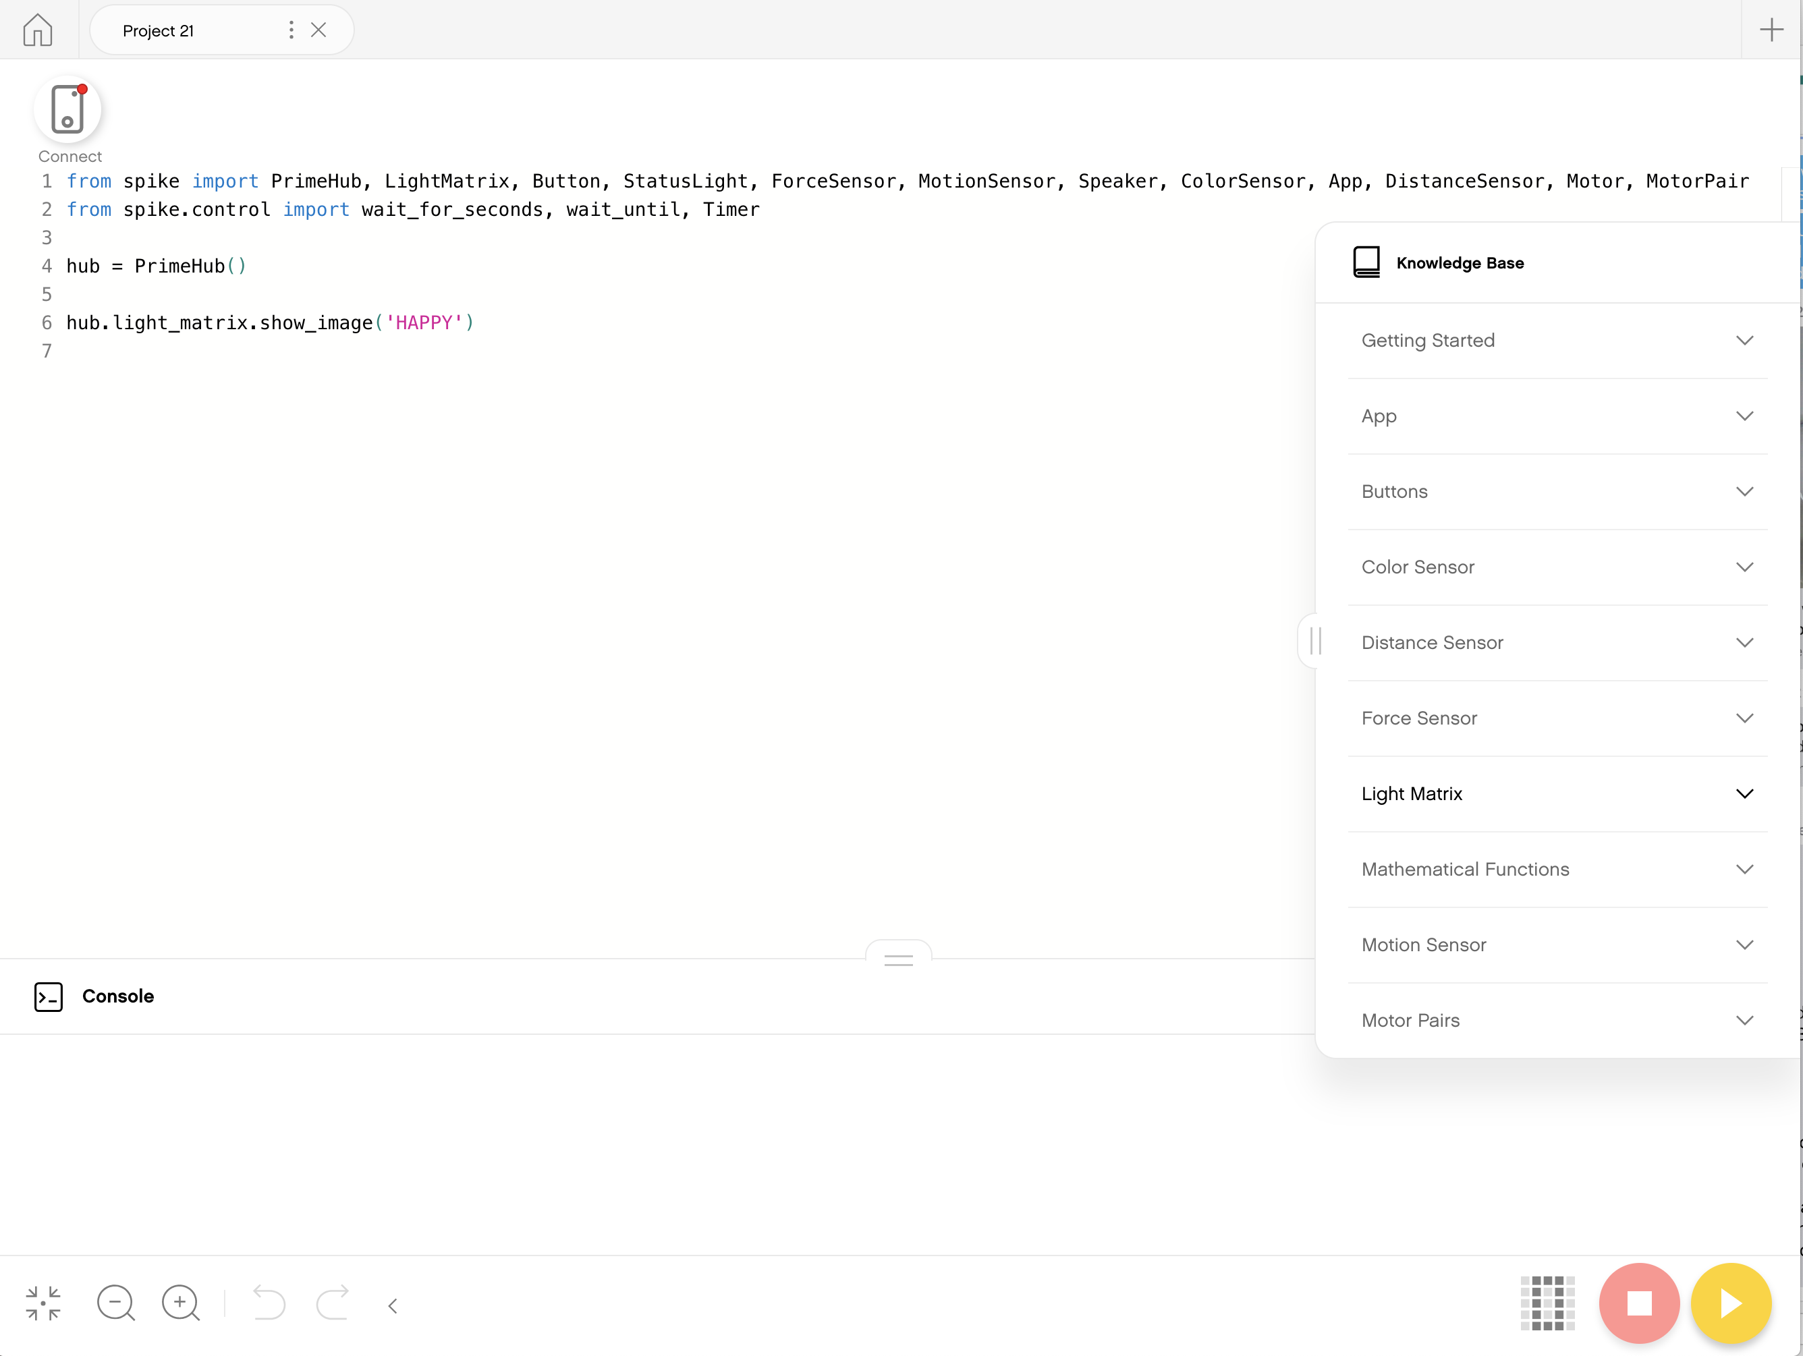
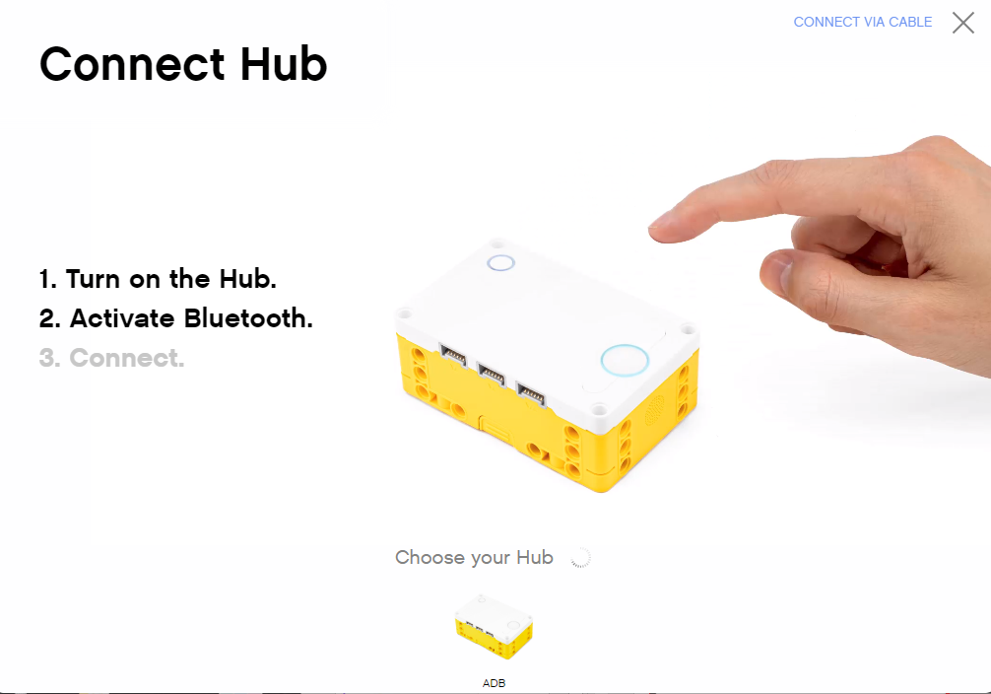
Connecting to brick
The software will auto-connect to the brick if you are using USB
To connect over Bluetooth, click the connect icon in the software.
Enable Bluetooth by pressing the Bluetooth button on the brick.
Your brick will show up in the list at the bottom. Click connect on your hub

Slide 14
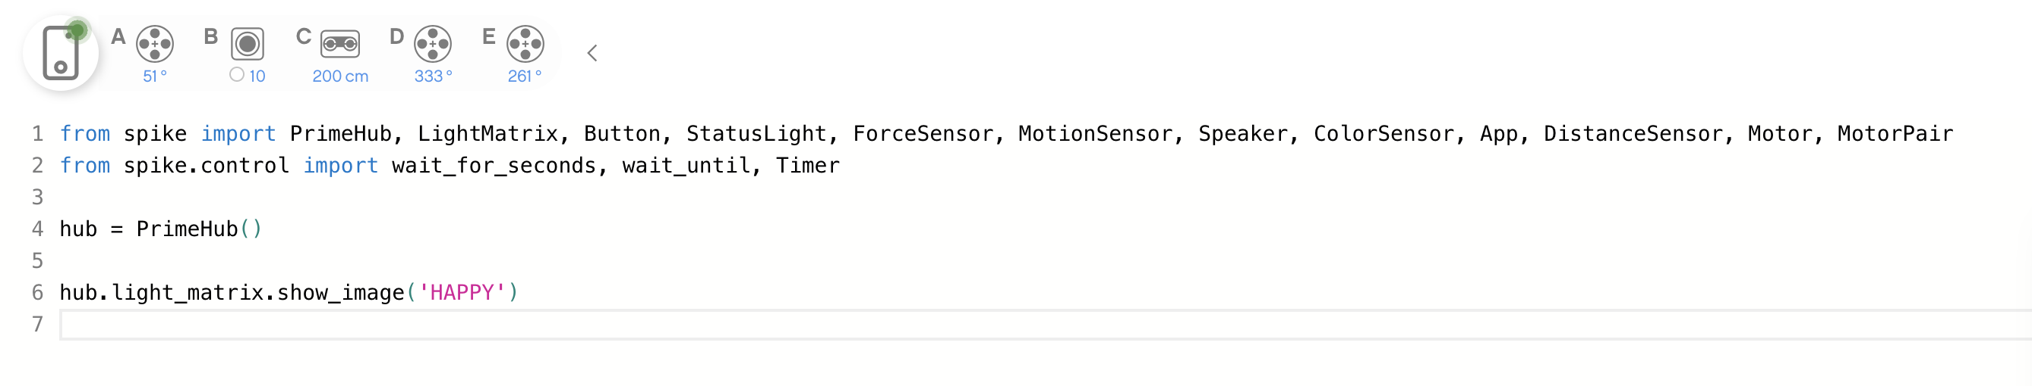
DEFAULT PYTHON CODE
All Python programs will begin with the following code by default.
You should keep this code in all projects you create expect for the following: hub.light_matrix.show_image('HAPPY')

Slide 15
CREDITS
This lesson was created by Arvind Seshan for SPIKE Prime Lessons
More lessons are available at www.primelessons.org
This work is licensed under a Creative Commons Attribution-NonCommercial-ShareAlike 4.0 International License.

